Slide 1



Introduction To Linux Kernel Development Session 7
Part 7: Kernel Facilities – Miscellaneous
Dexuan Cui, Steven French

Slide 2
Instructors
Dexuan Cui
Steven French

Slide 3
Instructor
Dexuan Cui
- Worked on Xen during 2006~2014 at Intel, mainly on enabling VT-x (VMX).
- Have been working at LSG on the Linux/FreeBSD Hyper-V drivers since then.
Worked on the FreeBSD Hyper-V drivers: enhanced the disk/network performance, ported the vPCI driver.
Implemented the Linux Hyper-V Sockets driver; implemented the suspend/resume ops for Linux VMBus state for Linux VM hibernation; co-maintain Hyper-V/Azure Core Drivers.
Implemented and maintain the Linux MANA VF NIC driver (drivers/net/ethernet/microsoft/mana/) with Haiyang Zhang.
Working on the Linux CVM kernel support (AMD SEV-SNP and Intel TDX).

Slide 4
Instructor
Steven French
- Original author, and maintainer of the Linux SMB3 network filesystem client (cifs.ko), one of the more active Linux filesystems, and also co-maintainer of the new kernel server (ksmbd).
Member of the Samba team (and original author of the 'net' utility)
Work in the Azure Files team
Formerly was File Systems Architect at the IBM Linux Technology Center
Rice University (Bachelors CS, Masters Computer Engineering)

Slide 5
Session Logistics
We will devote 15 minutes at the start of each session to answer questions or to deal with any spillover from the previous session.
There will be a 10-minute break around the start of the second hour
Questions are welcome throughout the session​
Both on the Teams channel as well as live during the session​
All sessions are recorded​

Slide 6
Last week
Answer questions or deal with any spillover from the previous session.

Slide 7
Kernel Facilities – Miscellaneous
Topics Covered:
Iterators (container_of(), list_for_each_entry().)
ID management (idr_alloc(), ida_alloc())
Time, Timeout, Jiffies, HZ
Interrupt/process/atomic context
Basic Linux interrupt handling
Hard irq handler
softirq, tasklet, workqueue
Threaded irqs
Lab:
~/class-projects/week7
1. Combine the device and bus modules into one module
2. Replace the dedicated thread in the device with "work"
More examples: https://github.com/dcui/kernel-examples.git

Slide 8
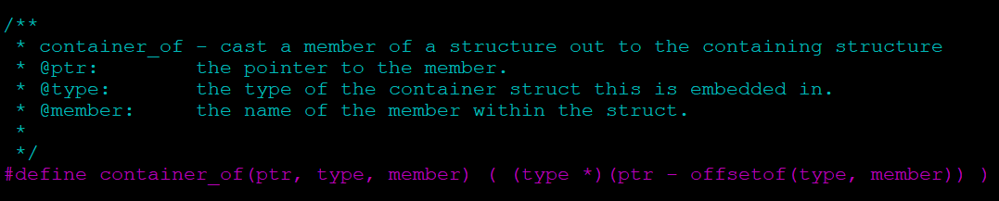
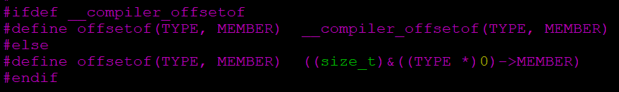
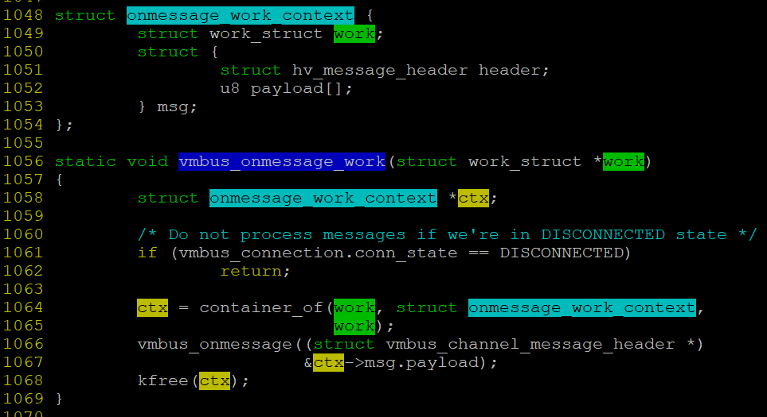
Understanding container_of()
container_of() is defined in include/linux/container_of.h
offsetof() is defined in include/linux/stddef.h
An example in drivers/hv/vmbus_drv.c
ctx = kmalloc(sizeof(*ctx) + payload_size, GFP_ATOMIC);
…
INIT_WORK(&ctx->work, vmbus_onmessage_work);
… schedule_work(&ctx->work);
Quiz: Line 1068 frees the ctx object. Is this safe?

Slide 9
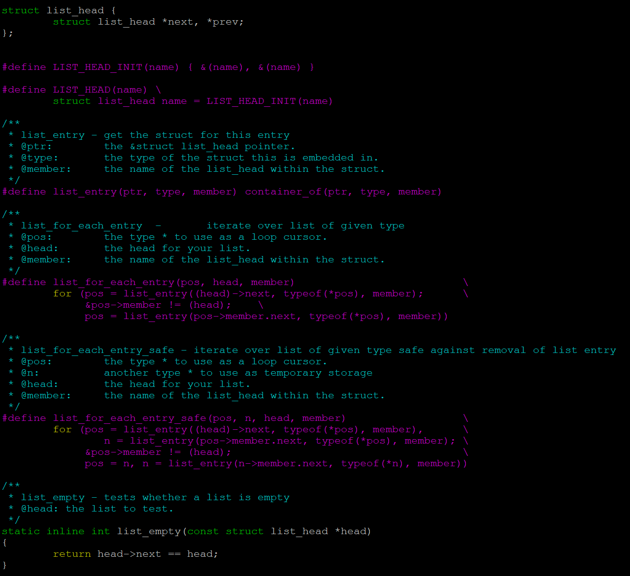
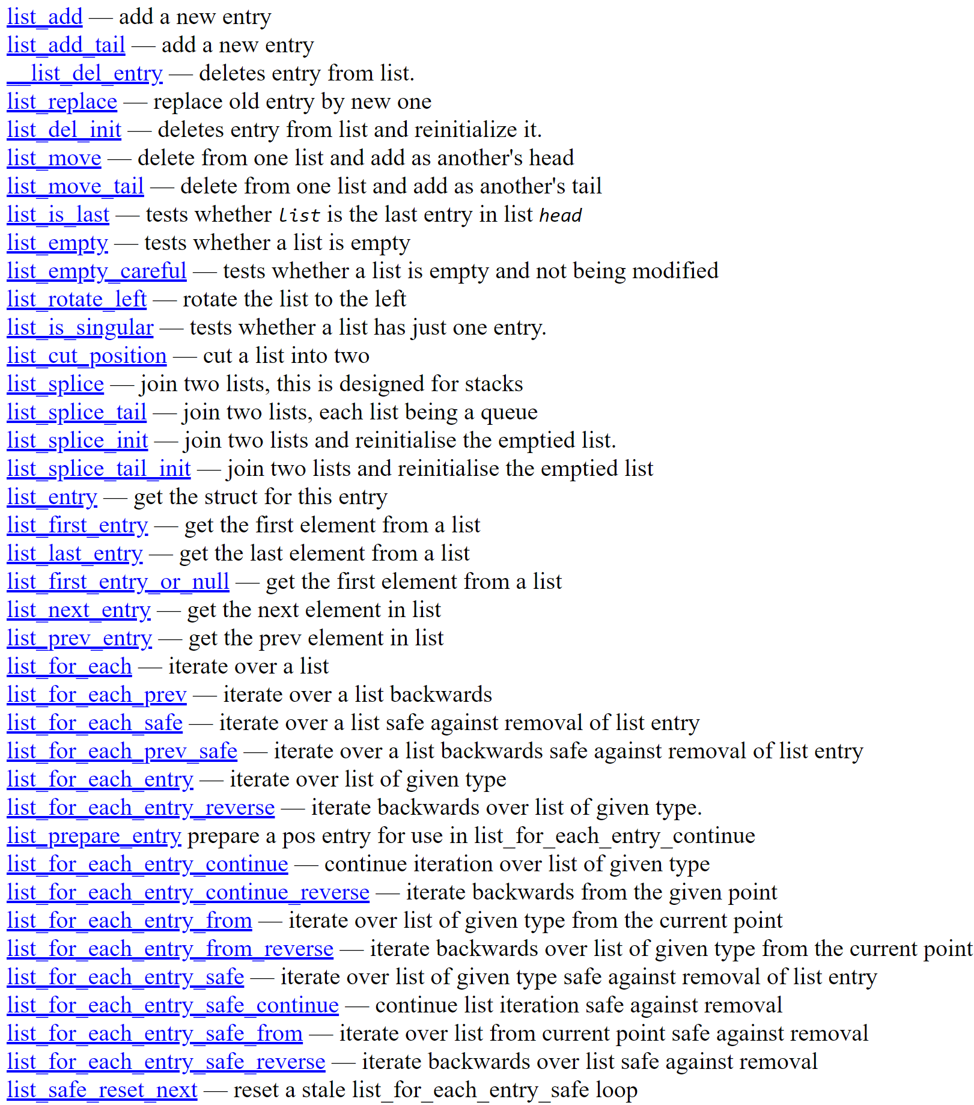
Understanding list_head
The doubly-linked list in Linux kernel is “struct list_head”.
The full API list:

Slide 10
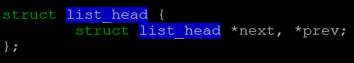
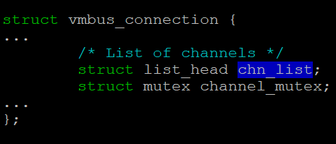
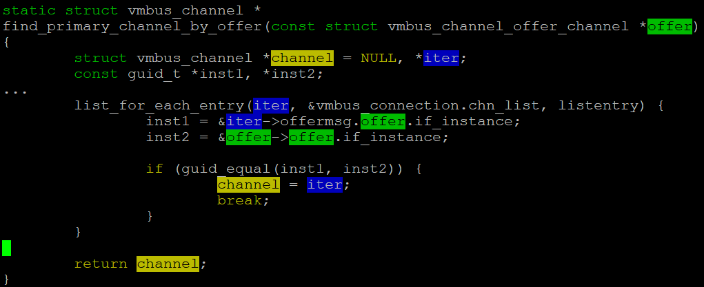
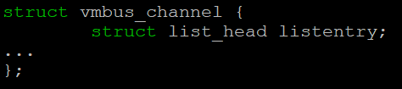
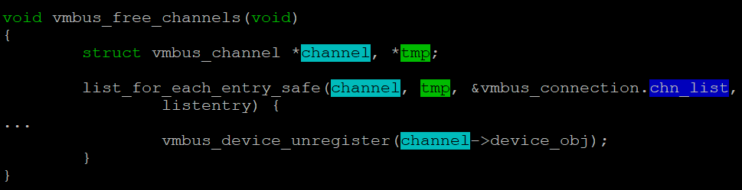
Understanding list_head (an example in hv_vmbus)
INIT_LIST_HEAD(&vmbus_connection.chn_list);
…
list_add_tail(&newchannel->listentry, &vmbus_connection.chn_list);
…
list_del(&channel->listentry);

Slide 11
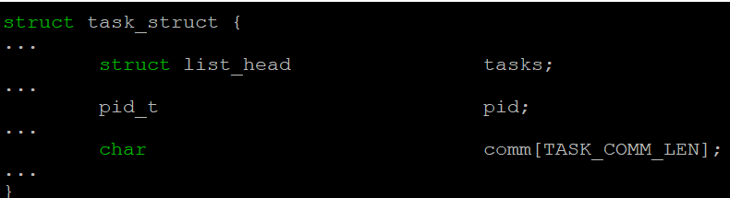
Lab 1: write a module to list the PIDs /names of all the processes
Hints:
There is a “current” variable pointing to the current process’s task_struct
There is also a global variable “init_task”.
Refer to the demo code

Slide 12

What is an “ID” and how can we manage ids in kernel?
ID: “A small number which identifies a thing”
Why do they matter?
They are used everywhere in the kernel: process ids, file descriptors, SCSI tags, inode numbers, packet identifiers in networking …
How can Linux helper functions make this easier for everyone? By two mechanisms:
“IDR” … map an id to a pointer
“IDA” …. Allocate an id
Invented by Matthew Wilcox who also created (“xarrays” to make it
easier to handle arrays of pointers in Linux kernel)
Notes:
“A common problem to solve is allocating identifiers (IDs); generally small numbers which identify a thing. Examples include file descriptors, process IDs, packet identifiers in networking protocols, SCSI tags and device instance numbers. The IDR and the IDA provide a reasonable solution to the problem to avoid everybody inventing their own. The IDR provides the ability to map an ID to a pointer, while the IDA provides only ID allocation, and as a result is much more memory-efficient.” “Some users need to allocate IDs larger than INT_MAX. So far all of these users have been content with a UINT_MAX limit, and they use idr_alloc_u32(). If you need IDs that will not fit in a u32, we will work with you to address your needs.”
(see https://www.kernel.org/doc/html/latest/core-api/idr.html)

Slide 13
ID management (idr_alloc(), ida_alloc())
An IDR can allocate small integers and map them to pointers.
void idr_init(struct idr *idr)
Use DEFINE_IDR() for a statically allocated IDR.
int idr_alloc(struct idr *idr, void *ptr, int start, int end, gfp_t gfp);
int idr_alloc_u32(struct idr *idr, void *ptr, u32 *nextid, unsigned long max, gfp_t gfp);
void *idr_find(const struct idr *idr, unsigned long id);
void *idr_replace(struct idr *idr, void *ptr, unsigned long id);
void *idr_remove(struct idr *idr, unsigned long id);
idr_for_each_entry(idr, entry, id)
void idr_destroy(struct idr *idr);
An IDA can allocate small integers.
ida_init(struct ida *ida)
int ida_alloc(struct ida *ida, gfp_t gfp)
void ida_free(struct ida *, unsigned int id);
void ida_destroy(struct ida *ida);
See the full API list: https://www.kernel.org/doc/html/latest/core-api/idr.html
Notes:
“A common problem to solve is allocating identifiers (IDs); generally small numbers which identify a thing. Examples include file descriptors, process IDs, packet identifiers in networking protocols, SCSI tags and device instance numbers. The IDR and the IDA provide a reasonable solution to the problem to avoid everybody inventing their own. The IDR provides the ability to map an ID to a pointer, while the IDA provides only ID allocation, and as a result is much more memory-efficient.” “Some users need to allocate IDs larger than INT_MAX. So far all of these users have been content with a UINT_MAX limit, and they use idr_alloc_u32(). If you need IDs that will not fit in a u32, we will work with you to address your needs.”
(see https://www.kernel.org/doc/html/latest/core-api/idr.html)

Slide 14
Lab 2: Write a module to exercise the IDR APIs
Refer to the demo code

Slide 15
Time for Q & A: Any questions about content so far?

Slide 16
Kernel Notion of time
A large number of kernel functions are time-driven.
Absolute time: system uptime, time of day (date and time)
Relative time: schedule an event in future.
System timer: a programmable piece of hardware that generates interrupts at a future point in time.
Timer interrupt handler
Update the system uptime, the time of day, etc.
Scheduling, balance the run queues.
Run any dynamic timers that have expired.
And more…
Real-Time Clock
A nonvolatile device storing the time of day.
The kernel reads from RTC during boot and then no longer uses it for time keeping.

Slide 17
Kernel Notion of time (continued)
clock_event_device: [x86] PIT, local APIC timer, Hyper-V clockevent, etc.
clocksource: [x86] TSC, HPET, hyperv_clocksource, etc.
Long ago, the system timer was programmed to generate interrupts at a fixed frequency, which is called tick rate.
CONFIG_HZ: a static preprocessor const.
1 tick = 1 second / CONFIG_HZ. The global “jiffies” variable increased by CONFIG_HZ per second.
Higher tick rate (more accurate timed events and resource usage)?
lower tick rate (less timer interrupts and lower overhead)?
Servers: 100 Hz, Desktop systems: 1000 Hz, Trade-off: 250 Hz (typical).
Nowadays, we use a dynamic tick or tickless kernel.
CONFIG_HZ_PERIODIC is not set
CONFIG_NO_HZ_IDLE=y
CONFIG_NO_HZ_FULL is not set

Slide 18
Lab 3: check the time interrupt rate when the system is idle and busy
cat /proc/interrupts | grep HVS:; sleep 10; cat /proc/interrupts | grep HVS:
or
sudo yum install dstat
dstat -t --int –IHVS
When a Linux VM is idle, there should be 7 ~20 timer interrupts per vCPU per second.
When the VM is busy, there should be about 250 timer interrupts per vCPU per second (CONFIG_HZ=250)
Run some cpu-intensive work by for i in `seq 1 8`; do yes > /dev/null & done
Run pidof yes | xargs kill to terminate the processes.

Slide 19
The global variable “Jiffies”
Starts from 0 and increases by CONFIG_HZ per second.
jiffies vs. jiffies_64 (see include/linux/jiffies.h)
extern u64 jiffies_64;
extern unsigned long jiffies;
On x86-64: they’re the same.
On x86-32: jiffies is the lower 32 bits of jiffies_64 (don’t read jiffies_64 directly -- use get_jiffies_64() instead).
System uptime = (get_jiffies_64() - INITIAL_JIFFIES) / CONFIG_HZ.
Convert jiffies to/from seconds and microseconds
unsigned long next_tick = jiffies + 1; /* one tick from now */
unsigned long later = jiffies + HZ / 2; / * 0.5 second later */
unsigned int jiffies_to_msecs(const unsigned long j); unsigned int jiffies_to_usecs(const unsigned long j);
unsigned long msecs_to_jiffies(const unsigned int m);
unsigned long usecs_to_jiffies(const unsigned int);
The conversion may be inaccurate, e.g. usecs_to_jiffies(1) = 1 tick.
Actually, it starts from “INITIAL_JIFFIES” (i.e., -5 minutes).

Slide 20
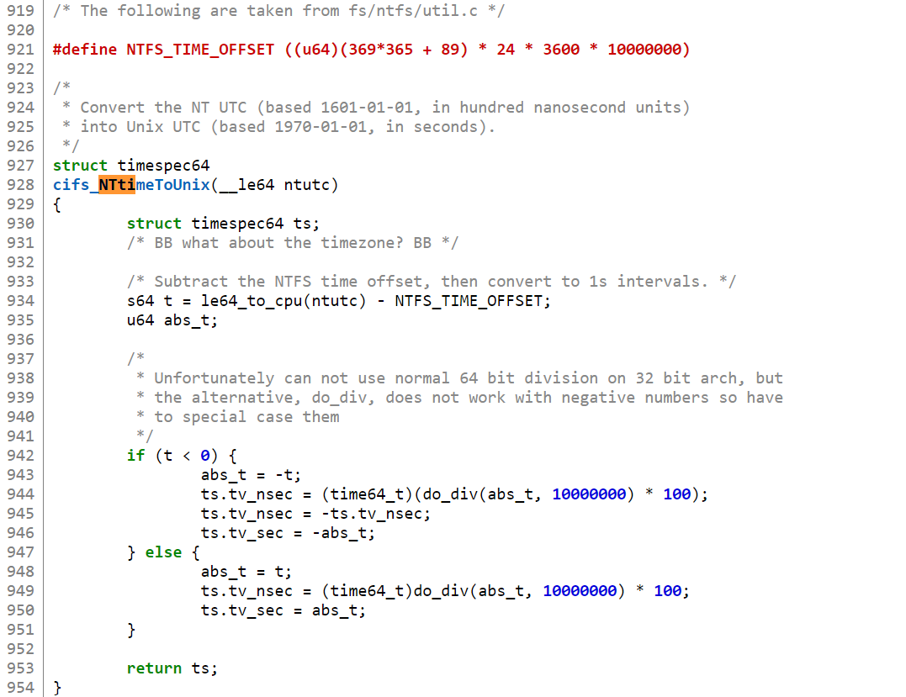
DCE Time (Windows time) is different than Linux time

Slide 21
The global variable “Jiffies”
Driver code typically uses jiffies, and sometimes get_jiffies_64().
x86-32: jiffies may overflow after (2^32 -1)/CONFIG_HZ seconds, i.e. 49.7 days if CONFIG_HZ=1000.
Do not use this:
unsigned long timeout = jiffies + HZ/2; /* timeout in 0.5s */
/* do dome work */
if (jiffies < timeout) { /* no timeout */} else { /* timeout */ }
Use the macros to compare tick counts:
#define time_after(a,b) ((long)((b) - (a)) < 0)) #define time_before(a,b) time_after(b,a)
#define time_after_eq(a,b) (long)((a) - (b)) >= 0))
#define time_before_eq(a,b) time_after_eq(b,a)

Slide 22
The jiffies-based timers
The basic APIs are:
#include <linux/timer.h>
static struct timer_list my_timer;
static void my_timer_fn(struct timer_list *timer)
{
printk("%s called (%lu)\n", __func__, jiffies);
mod_timer(&my_timer, jiffies + 10 * HZ); /* re-set the timer to go off every 10 seconds. */
}
Start a timer:
timer_setup(&my_timer, my_timer_fn, 0);
my_timer.expires = jiffies + msecs_to_jiffies(2000)); /* msecs_to_jiffies(2000) is the same as “2 * HZ”. */
add_timer(&my_timer);
Deactivate a timer:
del_timer(&my_timer);
del_timer_sync(&my_timer);
Check include/linux/timer.h and kernel/time/timer.c for more APIs and caveats.

Slide 23
High-resolution timers
The basic APIs are:
#include <linux/hrtimer.h>
struct hrtimer my_timer;
enum hrtimer_restart my_timer_fn(struct hrtimer *timer)
{
hrtimer_forward_now(timer, ns_to_ktime(100));
return HRTIMER_RESTART;
}
Start a timer:
hrtimer_init(&my_timer, CLOCK_MONOTONIC, HRTIMER_MODE_REL);
my_timer.function = my_timer_fn.
hrtimer_start(&my_timer, ns_to_ktime(100), HRTIMER_MODE_REL);
Deactivate a timer:
hrtimer_cancel(&my_timer);
Check include/linux/hrtimer.h and kernel/time/hrtimer.c for more APIs and caveats.

Slide 24
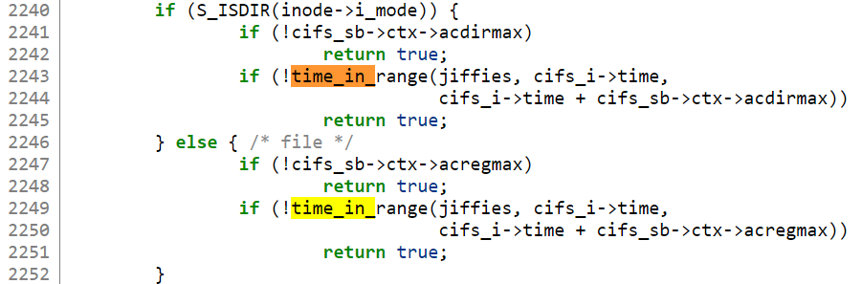
Example use of “Jiffies”
Is current time between two values “time_in_range”
See e.g. fs/cifs/inode.c

Slide 25
Delaying execution – busy looping
unsigned long timeout = jiffies + 10; /* 10 ticks */ /* assuming jiffies can increase */
while (time_before(jiffies, timeout))
;
versus
/* assuming jiffies can increase, and sleeping is allowed */ while (time_before(jiffies, delay))
schedule();

Slide 26
Delaying execution in atomic context (no sleeping)
void udelay(unsigned long usecs);
void ndelay(unsigned long nsecs);
void mdelay(unsigned long msecs);

Slide 27
Delaying execution in non-atomic context
The delay functions available in atomic context can also be used.
usleep_range(unsigned long min, unsigned long max);
msleep(unsigned long msecs);
msleep_interruptible(unsigned long msecs);
void ssleep(unsigned int seconds);
void fsleep(unsigned long usecs);
See https://www.kernel.org/doc/Documentation/timers/timers-howto.rst

Slide 28
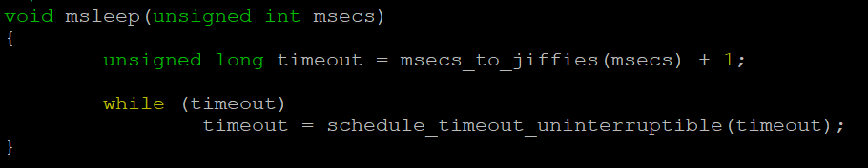
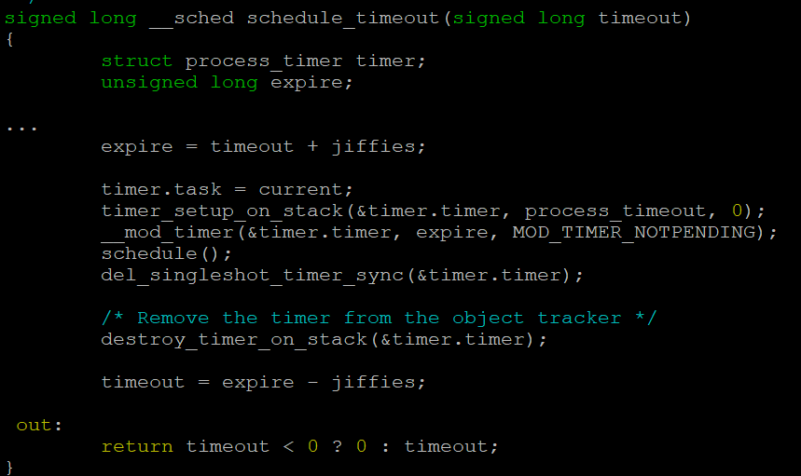
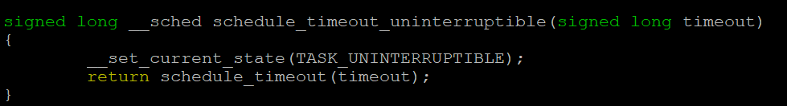
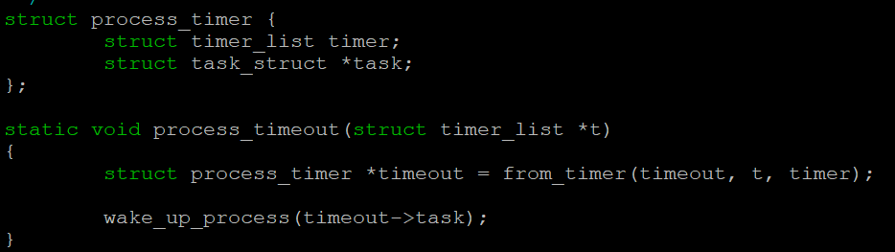
How is msleep() implemented?

Slide 29
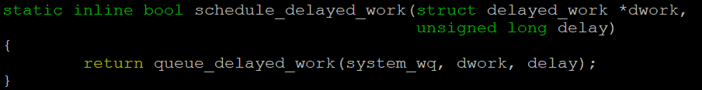
Delaying execution – delayed work
static void my_dwork(struct work_struct *w)
{
void *my_ptr = container_of(w, struct my_struct_t, dwork.work);
/* process *my_ptr */
}
static struct my_struct_t {
struct delayed_work dwork;
void *my_ptr;
} my_struct;
INIT_DELAYED_WORK(&my_struct.dwork, my_dwork);
/* schedule a delayed work that will run in 10 seconds */
schedule_delayed_work(&my_struct.dwork, 10 * HZ)
/* cancel the delayed work */
cancel_delayed_work_sync(&my_struct->dwork);

Slide 30
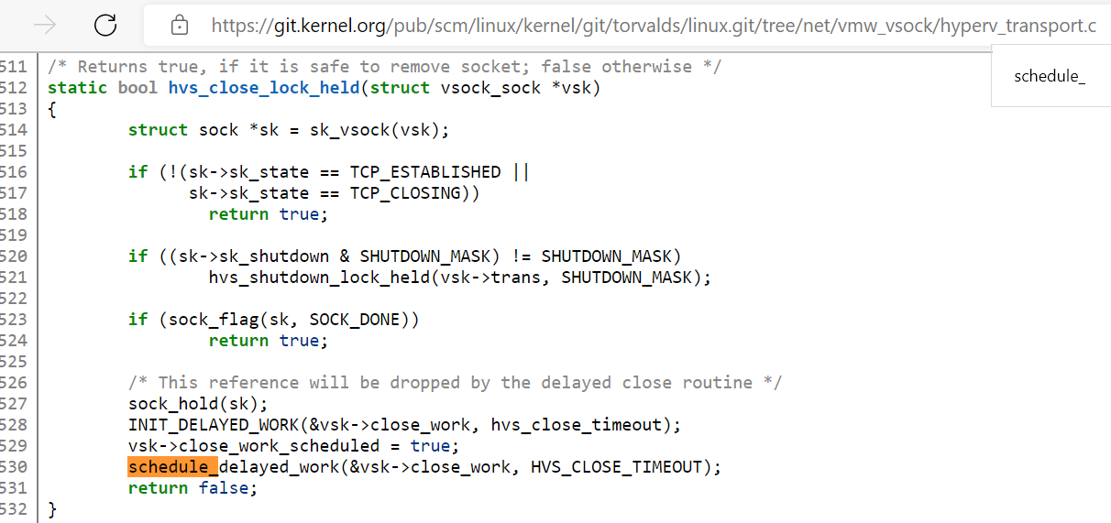
Delaying execution – delayed work example
Example from hyperv_transport.c, delay closing socket until safe to remove

Slide 31
Break: Q & A

Slide 32
Review: Execution context (this slide is from week 6)
Userspace
Can be preempted by interrupt – timer, I/O, etc.
Can migrate to another CPU
Kernel thread
System call
Can be preempted or interrupted unless disabled
Interrupt
Soft – triggered by HW, same level disabled
Hard – runs on return to userspace (a.k.a DPC)
Tasklets – singleton version of softirqs

Slide 33
Interrupt context vs. process context
Interrupt context examples
Here “interrupt” means “external interrupts” and not “exceptions” (let’s ignore NMIs).
Handlers of hard interrupts, including timer interrupt handler.
Handlers of softirq/tasklet (“bottom halves”), including timer handler.
Process scheduling is impossible in interrupt context.
Process context examples
An application is running in user-space.
The kernel is running in a syscall handler on behalf an application.
The kernel is running in the page fault handler on behalf an application.
The kernel is running a kernel-mode thread, e.g., the delayed work.

Slide 34
atomic context vs. non-atomic context
atomic context -- sleeping is disallowed, i.e. process scheduling is off.
void *ptr = kmalloc(size, GFP_ATOMIC);
mdelay();
Handlers of hard interrupts or softirq/tasklet
Process context with a spinlock held.
Process context with local interrupts turned off.
Process context with preempt_disable() called
#define get_cpu() ({ preempt_disable(); __smp_processor_id(); })
Non-atomic context -- sleeping is allowed.
void *ptr = kmalloc(size, GFP_KERNEL);
mdelay() or msleep();
Process context with no spinlock held.
Process context with local interrupts turned on
Process context with preempt_disable() called
Debugging with CONFIG_DEBUG_ATOMIC_SLEEP=y

Slide 35
Basic Linux interrupt handling (device driver’s perspective)
Hard interrupt handler (a.k.a. Interrupt Service Routine)
It can be executed at any time, if local interrupts are not off.
When it’s running, local interrupts are disabled, so no nesting interrupt handling.
Linux supported nested interrupt handling before 2010.
A handler may run on multiple CPUs.
The handler must not sleep.
The handler is also called the “top half”:
It should run fast and resume the execution of the interrupted code asap.
It often offloads further handling to “bottom halves”: softirqs, tasklets, workqueues, threaded irqs.
The “bottom halves” run with local interrupts enabled.
Typically, a driver requests an interrupt handler using
int request_irq(unsigned int irq, irq_handler_t handler, unsigned long flags,
const char *name, void *dev);

Slide 36
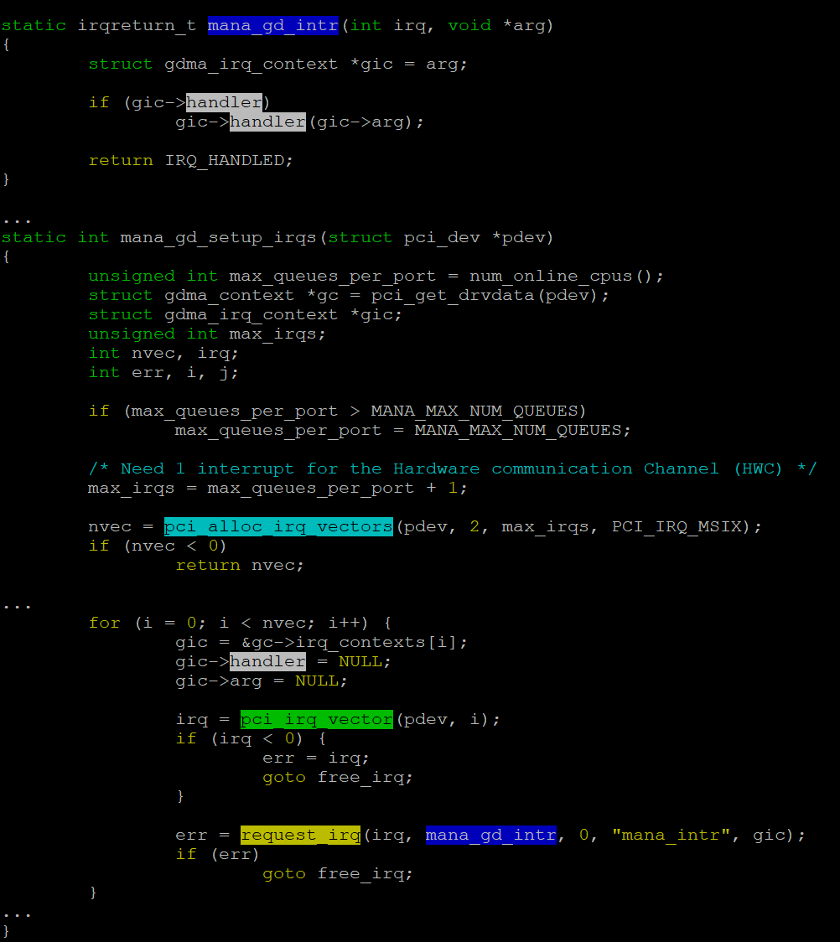
Basic Linux interrupt handling (an example in the MANA VF NIC driver)

Slide 37
Basic Linux interrupt handling (softirqs)
softirqs -- interrupt context.
Don’t confuse it with the x86 CPU instruction “INT n”.
Basically, it’s a fixed array of handlers plus a per-cpu bitmask of pending softirq events.
Statically allocated at compile time – typically, new drivers shouldn’t add new softirqs.
An interrupt handler marks some softirq for execution before returning and the softirq runs at a suitable time:
In the return from the interrupt handler.
Normally softirqs should be fast. In case softirqs run too long (e.g. >2ms), __do_softirq() runs wakeup_softirqd.
In the per-CPU ksoftirqd kernel thread.
A handler may run on multiple CPUs. The handler must not sleep.
Want to dig into the code? see open_softirq(), raise_softirq(), invoke_softirq(), __do_softirq().

Slide 38
Basic Linux interrupt handling (tasklets)
tasklets (built on top of softirqs) -- interrupt context.
A dynamic list of handlers to be executed. The handlers must not sleep.
A handler can run on only one CPU at the same time.
Basic tasklet APIs
void tasklet_init(struct tasklet_struct *t, void (*func)(unsigned long), unsigned long data);
void tasklet_setup(struct tasklet_struct *t, void (*callback)(struct tasklet_struct *))
void tasklet_schedule(struct tasklet_struct *t);
void tasklet_disable(struct tasklet_struct *t);
void tasklet_enable(struct tasklet_struct *t);
void tasklet_kill(struct tasklet_struct *t);
Check include/linux/interrupt.h for the full API list
An interesting read: Modernizing the tasklet API

Slide 39
Basic Linux interrupt handling (workqueues)
workqueues -- process context
The handler may sleep.
A “work” on a workqueue is often scheduled from a hard irq or tasklet handler.
Basic workqueue APIs
struct work_struct my_work;
INIT_WORK(&my_work, work_handler);
schedule_work(&my_work);
queue_work(my_work_queue, &my_work);
Check include/linux/workqueue.h for the full API list

Slide 40
Basic Linux interrupt handling (threaded irqs)
The main goal is to reduce system latency caused by hard irq handlers or softirqs/tasklets.
int request_threaded_irq(unsigned int irq, irq_handler_t handler, irq_handler_t thread_fn,
unsigned long flags, const char *name, void *dev);
handler: if the interrupt can be handled quickly (e.g. in 100us), it can return IRQ_HANDLED; otherwise, it should return IRQ_WAKE_THREAD.
thread_fn:
This function may sleep.
The thread can be scheduled to run together with other kernel threads and user processes.

Slide 41
Lab 4: Analyze how vmbus_isr() offloads work to tasklets/wokqueues
The VMBus interrupt handler is drivers/hv/vmbus_drv.c: vmbus_isr().
VMBus “message” interrupts are further handled in tasklet.
vmbus_isr() -> tasklet_schedule(&hv_cpu->msg_dpc);
drivers/hv/hv.c: tasklet_init(&hv_cpu->msg_dpc, vmbus_on_msg_dpc, (unsigned long) hv_cpu);
vmbus_on_msg_dpc() offloads further handling to a workqueue.
Depending on the VMBus channel/device types, VMBus “event’ interrupts can be handled:
By the sync function call: vmbus_isr() -> vmbus_chan_sched() -> channel->onchannel_callback()
In a tasklet:
tasklet_schedule(&channel->callback_event);
drivers/hv/channel_mgmt.c: tasklet_init(&channel->callback_event, vmbus_on_event, (unsigned long)channel);
Submit a patch to replace the tasklet_init() usages with tasklet_setup()?

Slide 42
Thank You!
Q & A

Slide 43
Next Week
Linux Device, Driver & Bus Model
Please complete the lab work ~/class-projects/week7.
Please provide feedback: https://aka.ms/AzureAdvanced/feedback

